Slide 1
대우제약 DWP-DN11-P01R 임상시험 PK 가분석 결과
가톨릭 대학교 서울성모병원 임상약리과

Slide 2
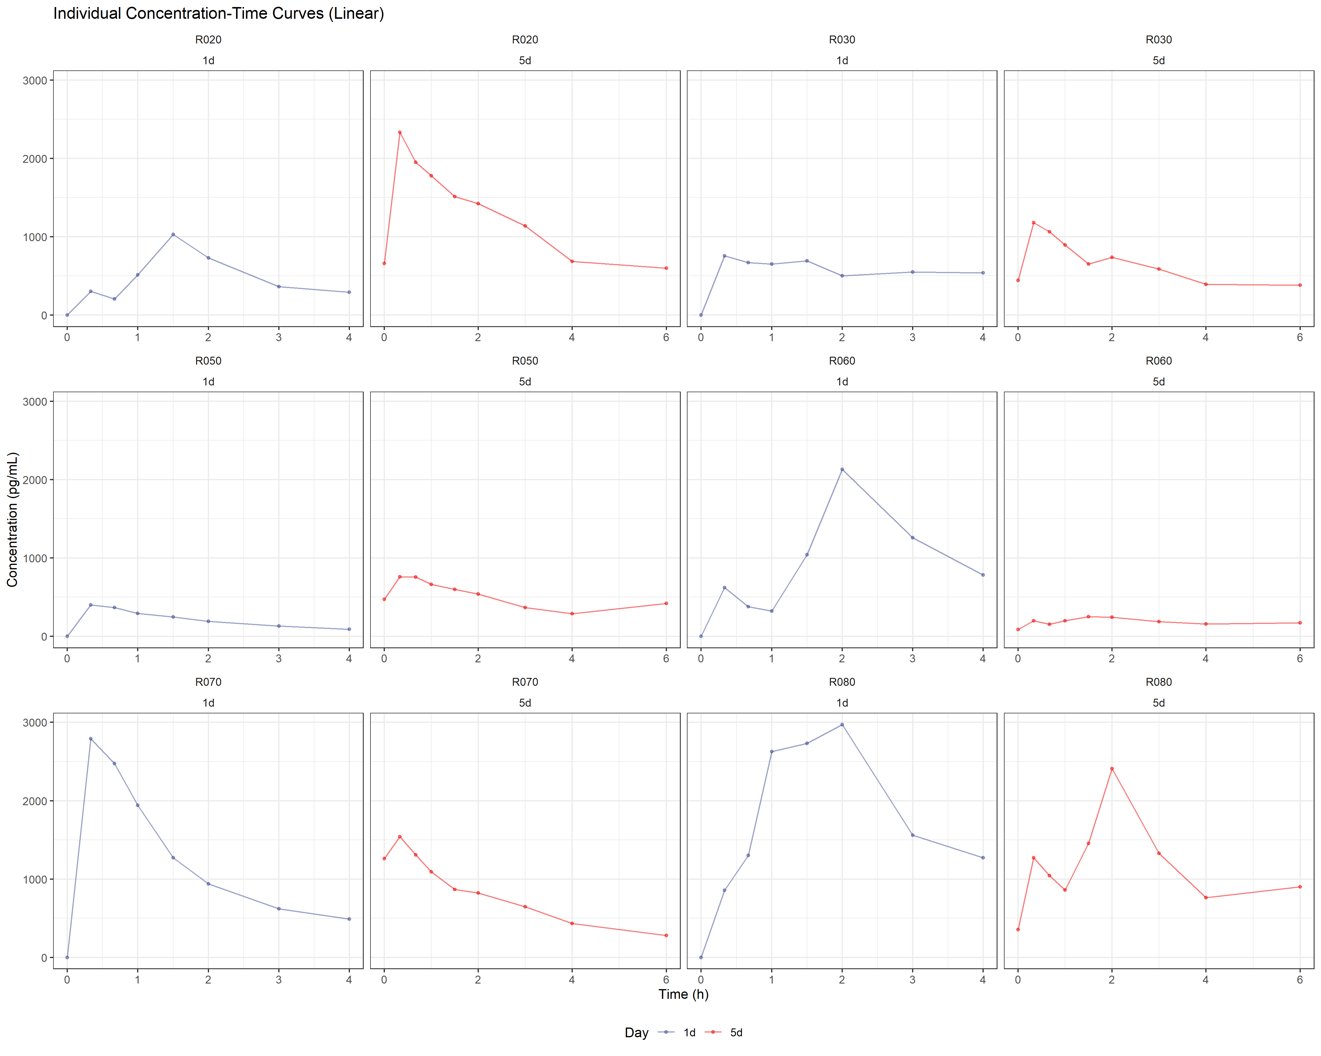

Slide 3
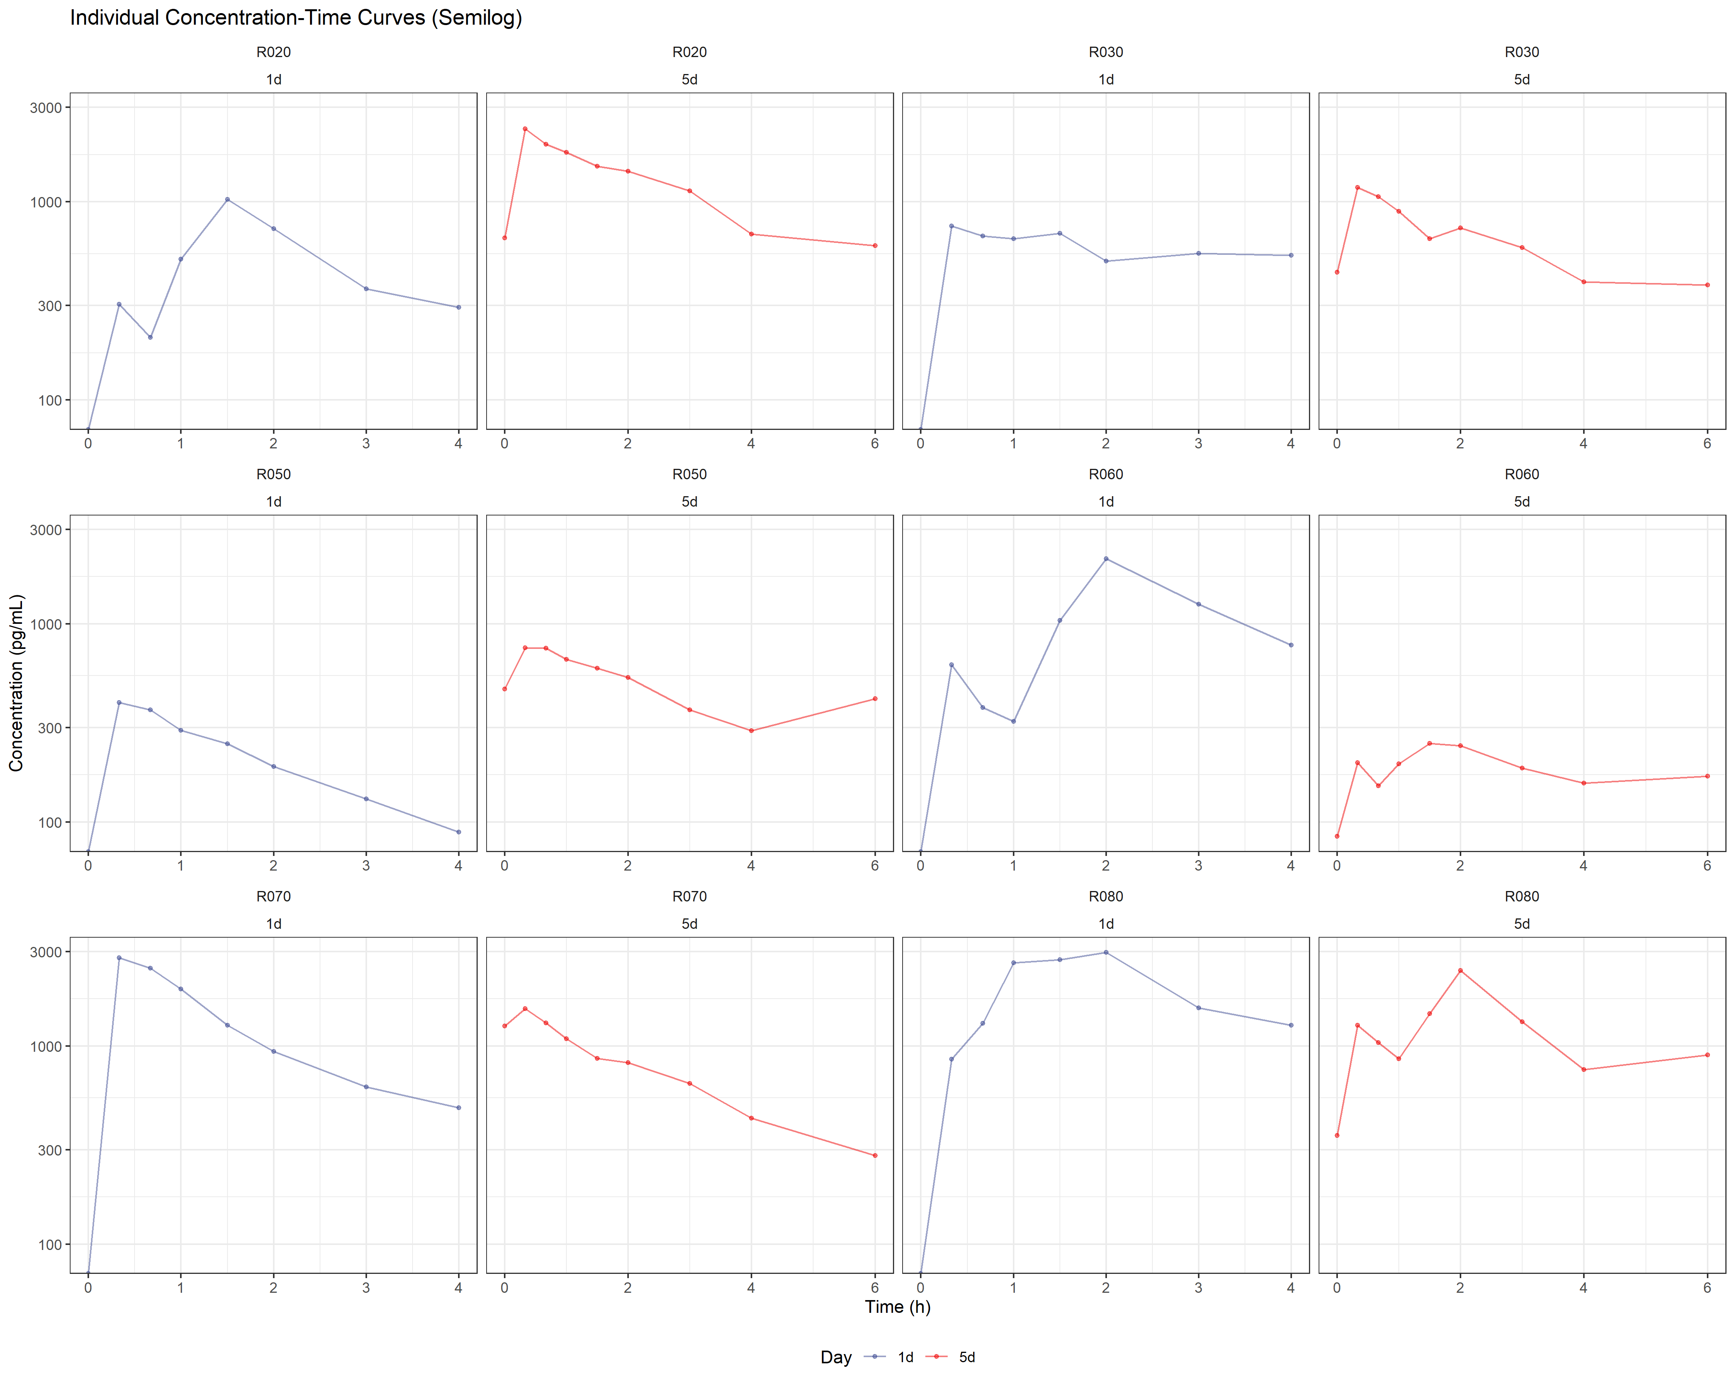

Slide 4
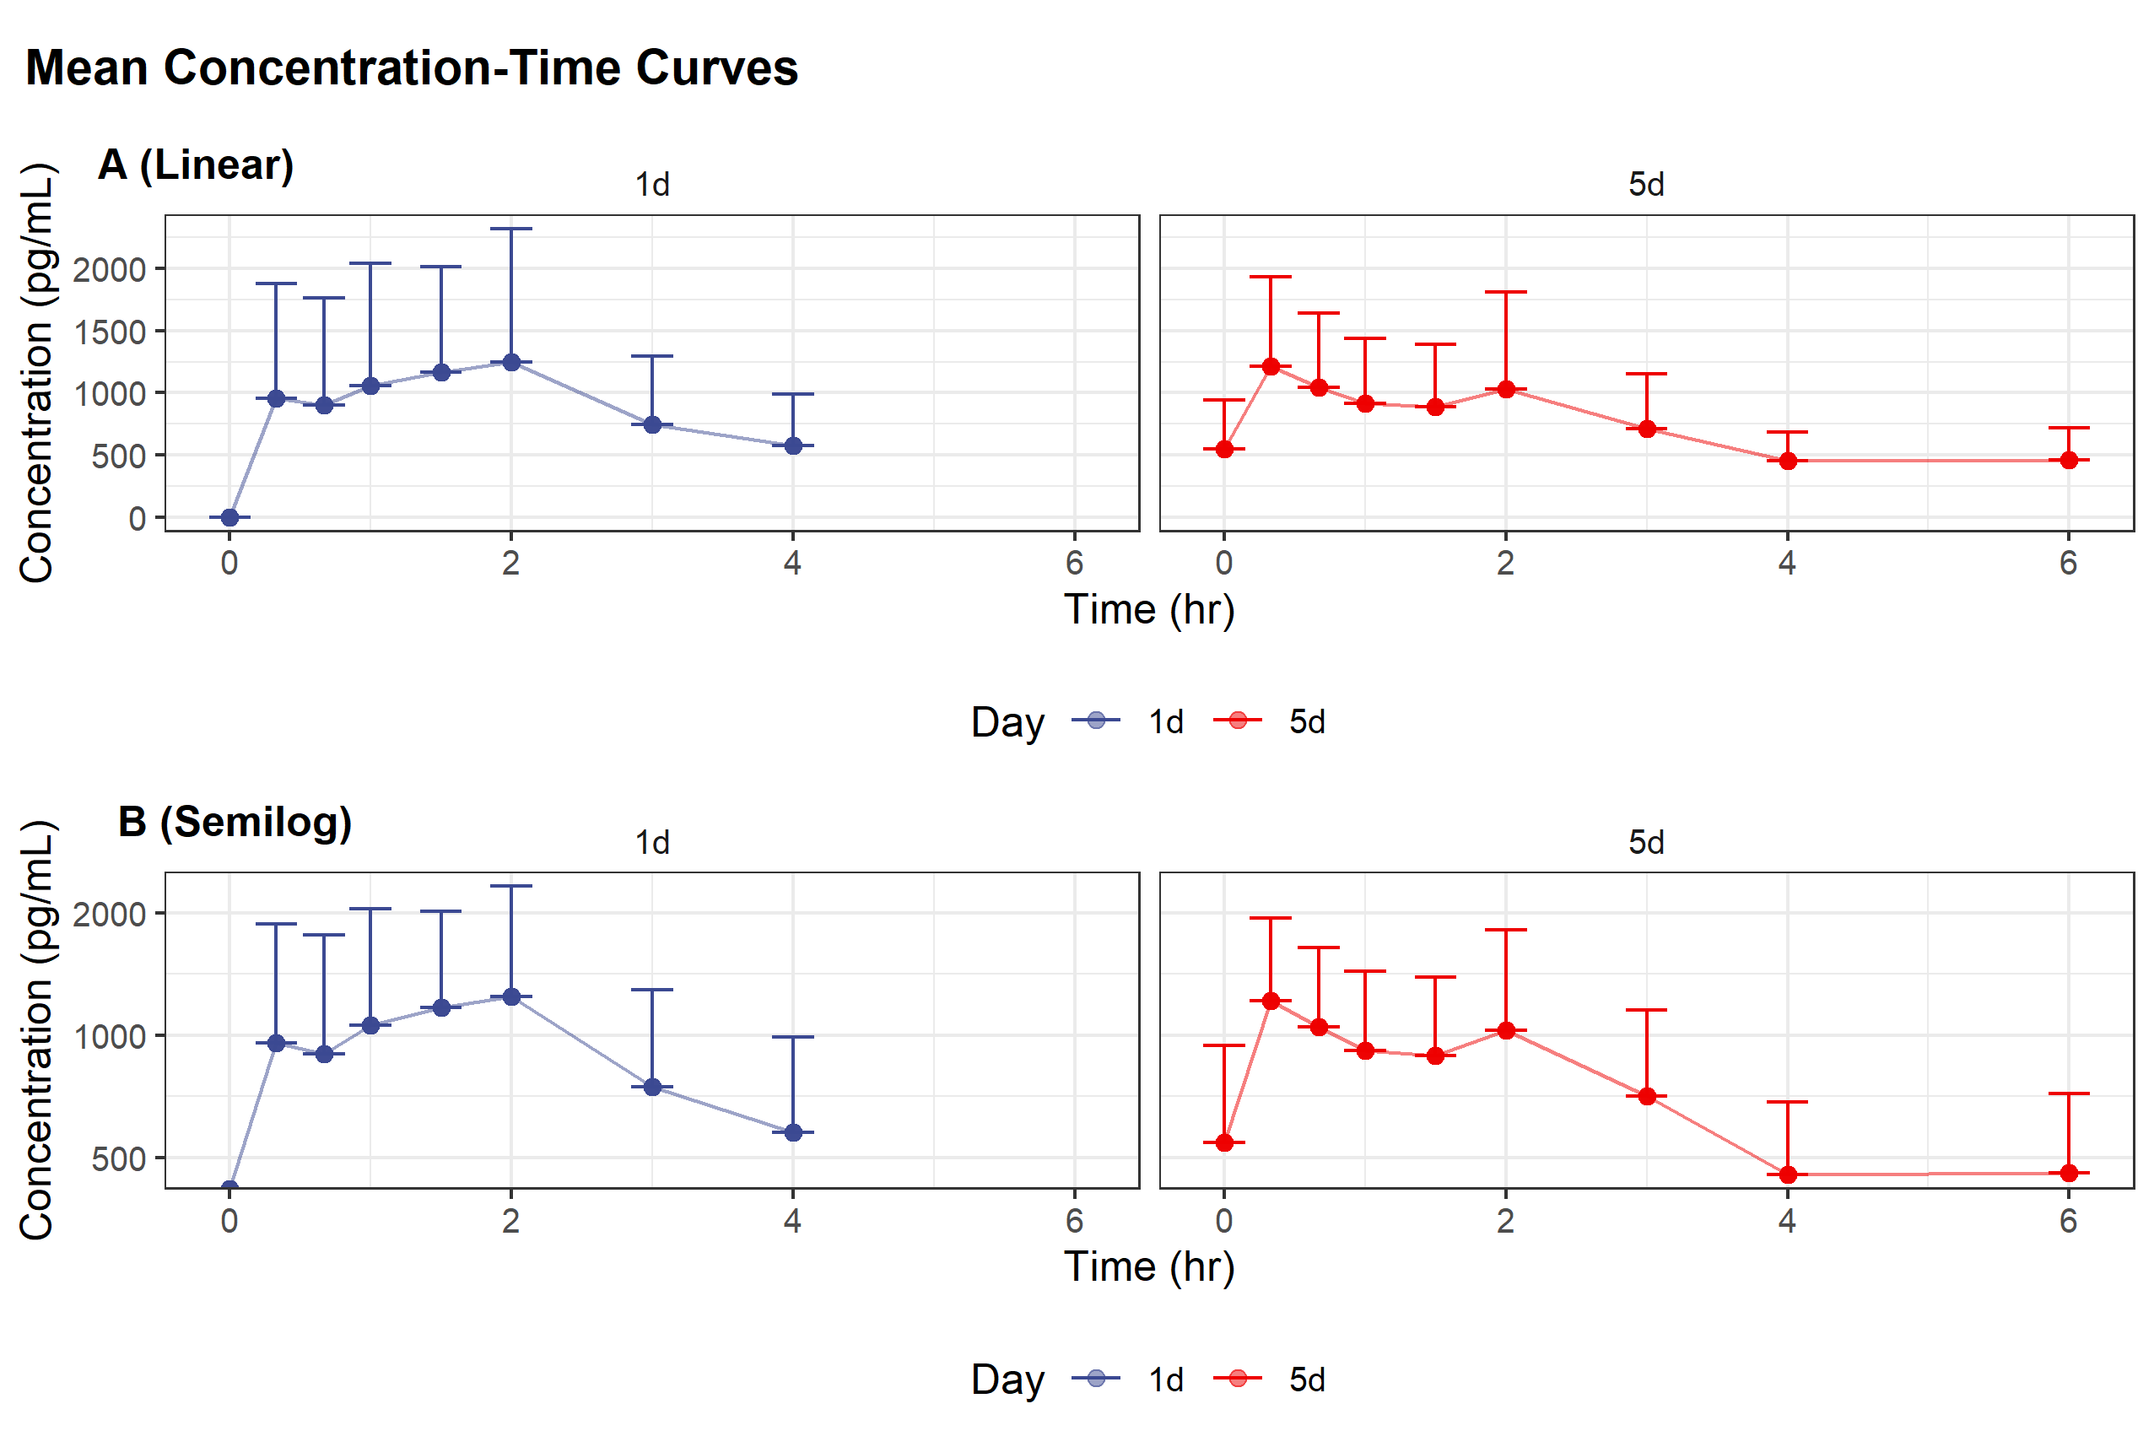

Slide 5
Summary of plasma concentration of rebamipide (pg/mL)
Day | Time | N | Mean ± SD | CV(%) | Median | Min | Max
1 | 0h (pre-dose) | 6 | 0.00 ± 0.00 | NA | 0 | 0 | 0
1 | 0.33h | 6 | 955.43 ± 924.32 | 96.74 | 688.85 | 303.74 | 2793.56
1 | 0.67h | 6 | 899.72 ± 863.01 | 95.92 | 524.51 | 207.2 | 2473.6
1 | 1h | 6 | 1057.72 ± 984.20 | 93.05 | 581.27 | 290.92 | 2628.91
1 | 1.5h | 6 | 1168.66 ± 843.62 | 72.19 | 1034.72 | 247.85 | 2730.27
1 | 2h | 6 | 1243.97 ± 1075.80 | 86.48 | 835.18 | 190.29 | 2972.96
1 | 3h | 6 | 746.77 ± 548.16 | 73.4 | 584.58 | 131 | 1560.35
1 | 4h | 6 | 576.42 ± 412.41 | 71.55 | 512.77 | 88.88 | 1270.27
5 | -8h(pre-dose) | 6 | 357.54 ± 206.32 | 57.71 | 313.3 | 146.34 | 716.92
5 | 0h(pre-dose) | 6 | 544.71 ± 397.53 | 72.98 | 455.48 | 84.82 | 1261.16
5 | 0.33h | 6 | 1213.65 ± 721.72 | 59.47 | 1225.32 | 199.03 | 2334.28
5 | 0.67h | 6 | 1044.79 ± 594.62 | 56.91 | 1052.41 | 152.64 | 1949.06
5 | 1h | 6 | 914.20 ± 521.74 | 57.07 | 878.23 | 196.73 | 1779.44
5 | 1.5h | 6 | 889.08 ± 501.90 | 56.45 | 759.22 | 249.76 | 1513.3
5 | 2h | 6 | 1029.20 ± 780.92 | 75.88 | 780.92 | 242.96 | 2409.63
5 | 3h | 6 | 708.77 ± 441.44 | 62.28 | 616.38 | 186.9 | 1328.13
5 | 4h | 6 | 453.40 ± 231.24 | 51 | 413.39 | 157.27 | 760.83
5 | 6h | 6 | 458.52 ± 260.00 | 56.7 | 399.8 | 170.4 | 900.81
Note: ND, BLQ는 0으로 처리함

Slide 6
Pharmacokinetic Parameters
Day | PK parameters | N | Mean ± SD | CV(%) | Median | Min | Max
1 | AUC_{last} (h*pg/mL) | 6 | 3612.72 ± 2447.53 | 67.75 | 3259.66 | 820.45 | 7603.95
1 | AUC_{inf} (h*pg/mL) | 4 | 4768.36 ± 3706.86 | 77.74 | 4332.44 | 1053.96 | 9354.6
1 | C_{max} (pg/mL) | 6 | 1680.16 ± 1097.72 | 65.33 | 1578.63 | 400.94 | 2972.96
1 | CL/F (L/h) | 4 | 602.01 ± 576.16 | 95.71 | 412.25 | 160.35 | 1423.2
1 | T_{max}(h) | 6 | 1.08 ± 0.84 | 77.97 | 0.92 | 0.33 | 2
1 | t_{1/2} (h) | 4 | 3.57 ± 3.70 | 103.6 | 1.83 | 1.52 | 9.12
1 | V/F (L) | 4 | 1941.10 ± 1339.08 | 68.99 | 1685.65 | 653.94 | 3739.16
5 | AUC_{tau} (h*pg/mL) | 6 | 4289.69 ± 2338.38 | 54.51 | 3937.65 | 1113.76 | 7095.31
5 | AUC_{inf} (h*pg/mL) | 6 | 7592.92 ± 4670.60 | 61.51 | 5722.4 | 3212.94 | 16207.22
5 | C_{max,ss} (pg/mL) | 6 | 1411.92 ± 859.68 | 60.89 | 1360.15 | 249.76 | 2409.63
5 | CL/F (L/h) | 6 | 254.55 ± 127.60 | 50.13 | 262.19 | 92.55 | 466.86
5 | T_{max,ss}(h) | 6 | 0.80 ± 0.75 | 93.38 | 0.33 | 0.33 | 2
5 | t_{1/2} (h) | 6 | 4.95 ± 2.39 | 48.3 | 4.33 | 2.57 | 8.54
5 | V/F (L) | 6 | 1946.74 ± 1909.12 | 98.07 | 1224.87 | 674.78 | 5751.52
Note: T_{max}이전 ND, BLQ는 0으로 처리하고 T_{max}이후 ND, BLQ는 제외하여 PK parameters를 산출함; Dose는 두방울(0.1mL) 안에 들어있는 rebamipide의 양 1.5mg으로 계산하여 CL/F, V/F 산출함; Day 1에서 fractional elimination rate(lambda_z)가 구해지지 않은 대상자 2명 제외(R060, R080)

